Slide 1


TEXT MINING AND SENTIMENT ANALYSIS
ADVANCEd DATa Science TRAINing I
data-action-lab.com

Slide 2
OUTLINE
Case Study: @BOTUS
Text Mining and NLP
Text Analysis Basics
Sentiment Analysis
Example: Movie Reviews

Slide 3
LEARNING OBJECTIVES

Slide 4
Case Study: @BOTUS and Trump&Dump
TEXT MINING AND SENTIMENT ANALYSIS
Sentiment Analysis of Tweets
(Greenstone, S. [2017], When Trump Tweets, This Bot Makes Money)
(Mettler, K. [2017], ‘Trump&Dump’: When POTUS tweets and stocks fall, this animal charity benefits)

Slide 5
@BOTUS and T&D
Some evidence pointed to the 45th POTUS’ tweets affecting the stock market.
Can sentiment analysis and A.I. be used to take real-time (fast) advantage of his unpredictable tweeting nature?
Enter NPR’s Planet Money’s @BOTUS and T3’s Trump&Dump.
Notes:
Objective of BOTUS and Trump & Dump

Slide 6

@BOTUS and T&D
https://www.youtube.com/watch?v=ZqI89XDNqg8 []
Sentiment analysis (or opinion mining) is the collection of algorithms used to identify the text writer's attitude (positive, negative, neutral, etc.) towards a specific topic/product.
“I can’t believe YOU’re the President!!!” vs. “I can’t believe you’re the PRESIDENT!!!”
Notes:
Sentiment analysis is the process of computationally identifying and categorizing opinions expressed in a piece of text, especially in order to determine whether the writer's attitude towards a particular topic, product, etc., is positive, negative, or neutral.

Slide 7
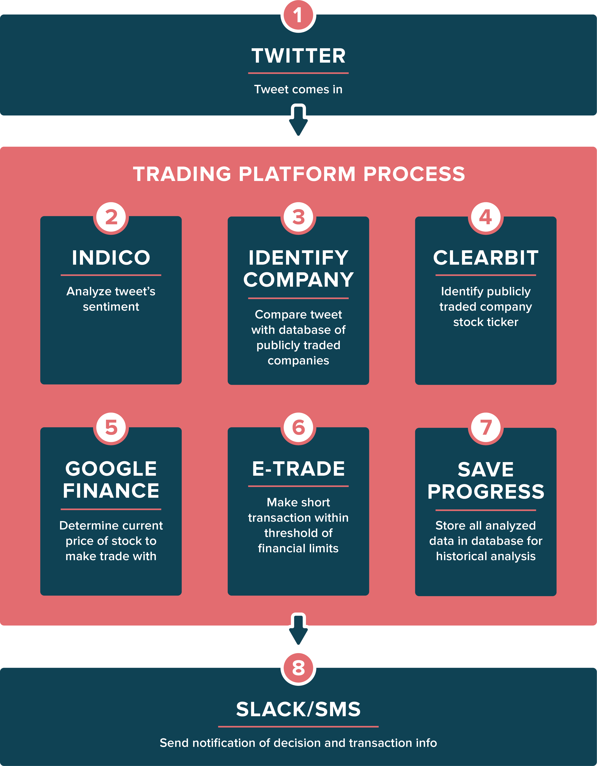
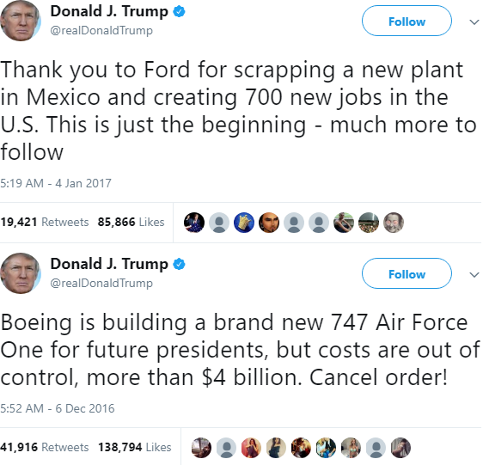
@BOTUS and T&D
Notes:
Sample tweets from @realDonaldTrump, and process for Trump&Dump

Slide 8
@BOTUS and T&D
Natural languages are rich, flexible, and can allow for syntax variations (+ for humans, – for bots).
A word’s meaning can be highly context-dependent.
Sarcasm, idioms, figures of speech… humans don’t even always recognize them.
Named-entity recognition: Apple (company) vs. apple (food).
Notes:
Strength and limitations of algorithms and procedure

Slide 9
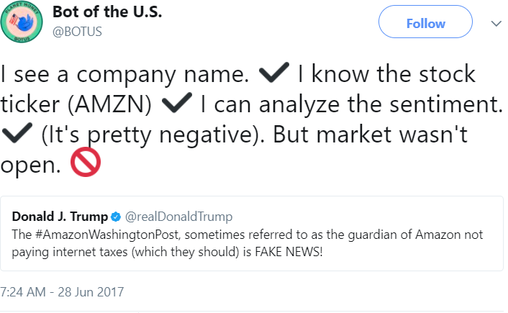
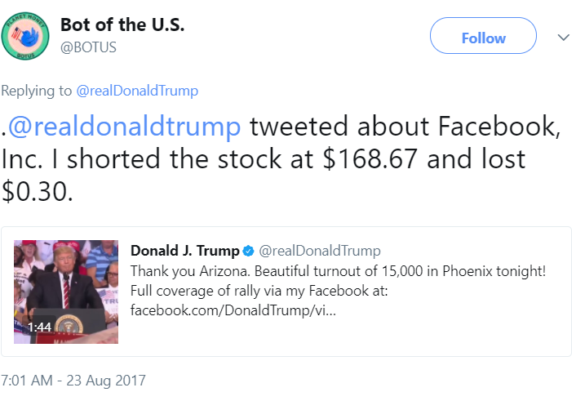
@BOTUS and T&D
T3’s president claimed T&D was profitable, but no details were provided and the website was recently taken down.
@BOTUS did not make a single trade in its first 4 months of operation (for various reasons)
Trading strategy was relaxed… leading to a loss on 1st trade.
Notes:
Results and sample tweets from BOTUS

Slide 10
@BOTUS and T&D
Successes:
presented well-executed sentiment analyses
simulated a process that finds an optimal trading strategy
But not so good as a predictive tool (unrelated to TM & NLP).
Descriptive data analysis can explain what has happened.
Modeling assumptions are not always applicable to the real world (in the predictive domain).

Slide 11
DISCUSSION
How important are visual cues in communications and business negotiations? How important is context?
On a related note, how easy is it to learn from someone whose context is different from yours (culturally AND professionally)?

Slide 12
Text Mining and NLP
TEXT MINING AND SENTIMENT ANALYSIS

Slide 13
Text Mining vs. Natural Lang. Proc.
Text Analysis is the collection of quantitative processes by which we attempt to extract useful (actionable) insights from text.
In many ways, text mining is about transitions from unorganized states to organized states (unstructured data to structured data). Natural language processing (NLP) is about getting machines to react “appropriately” when interacting with human languages.
In this course:
Text Mining refers to applications of data science tasks to text data
NLP is reserved for tasks that seek an “understanding” of languages
Notes:
Intro to text analysis
We will be talking about data reduction using NHL game between Ottawa Senators vs. Toronto Maple Leafs on February 18th of 2017

Slide 14
Text Mining Applications
Classification
authorship questions, distinguishing true/false statements, etc.
Value Estimation
sentiment analysis, bias detection, etc.
Clustering
topic modeling, information retrieval and recommendations, etc.
Others
text description, text visualization, etc.

Slide 15
Understanding Language
Syntax
lemmatization, part-of-speech tagging, sentence boundary disambiguation, etc.
Semantics
machine translation, language generation, named entity recognition, topic segmentation, questions and answers, etc.
Discourse
discourse analysis, summarization, etc.
Speech
recognition, segmentation, text-to-speech, etc.
Notes:
Excluded from the list, but Semantic also include questions and answers.

Slide 16
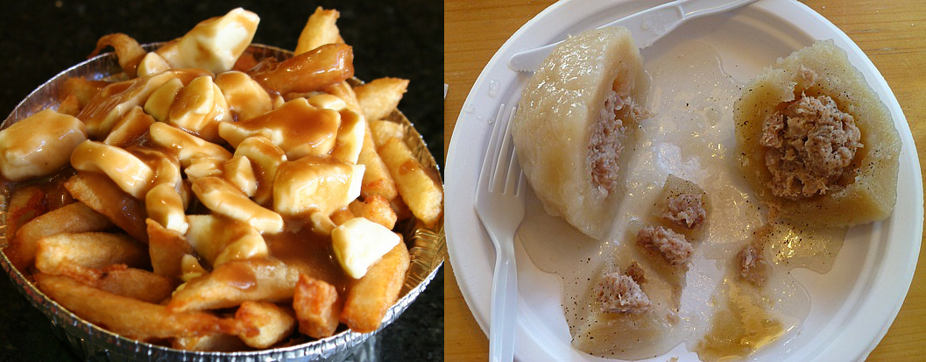
TM is Easy, NLP is AI-Hard
Notes:
Most natural human languages rules are dynamic, and usage may change drastically in space and time:
- A poutine is not the same delicious dish in New Brunswick as it is in Quebec, for instance.
- Issues also arise from dialect variations and individual specific speech patterns (sarcasm, idioms, figures of speech, etc)
- Therefore, the intended meaning is often clear to experienced human speakers based on the specific context; however, it is believed that natural language understanding is AI-hard.

Slide 17
Dream of the Red Chamber (红楼梦)
宝玉道：“一言难尽.” 说者便把梦中之事细说与袭人听了. 然后说至警幻所授云雨之情，羞得袭人掩面伏身而笑. (original by Cao Xueqin)
___________________________________________
“It’s a long story,” answered Pao-yu, then told his dream in full, concluding with his initiation by Disenchantment into the “sport of cloud and rain”. His-jen, hearing this, covered her face and doubled up in a fit of giggles. (translated by Yang Xianyi)
___________________________________________
After much hesitation he proceeded to give her a detailed account of his dream. But when he came to the part of it in which he made love to Two-in-one, Aroma threw herself forward with a shriek of laughter and buried her face in her hands. (translated by D. Hawkes)
___________________________________________
Bao Yudao: "A word is hard to do." The speaker described the dream things in detail and hit people. Then he talked about the cloud and rain sent by the police illusion, and was ashamed to hide behind and laugh. (machine translation)

Slide 18
Machine Translation
[https://www.youtube.com/watch?time_continue=13&v=EdsIMJg1m2E]
J'ai été au sud du sud au soleil Bleu blanc rouge les palmiers Et les cocotiers glacés Dans les pôles aux esquimaux bronzés Qui tricottent des ceintures flèchés Farcies Et toujours la Sophie Qui venait de partir
(Lindberg, R. Charlebois)
Notes:
Excluded from the list, but Semantic also include questions and answers.

Slide 19
Machine Translation
[https://www.youtube.com/watch?time_continue=13&v=EdsIMJg1m2E]
J'ai été au sud du sud au soleil Bleu blanc rouge les palmiers Et les cocotiers glacés Dans les pôles aux esquimaux bronzés Qui tricottent des ceintures flèchés Farcies Et toujours la Sophie Qui venait de partir
(Lindberg, R. Charlebois)
I was south of south in the sun Blue white red palm trees And frozen coconut palms In the poles to the tanned Eskimos Who knit arrow belts Stuffed And always Sophie Who had just left
???
Notes:
Excluded from the list, but Semantic also include questions and answers.

Slide 20
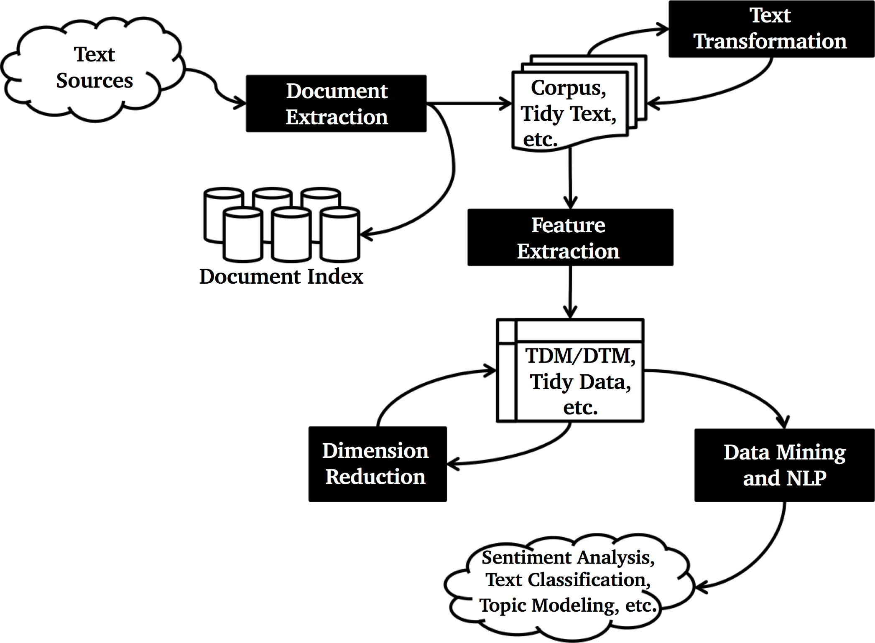

Slide 21
DISCUSSION
In numerical data analysis, it can be difficult (even for experts) to tell when the results are nonsensical. That’s not the case for text data analysis, as most of us can tell at a glance when something is off.
What steps can you take to help catch nonsensical results from being deployed/released too soon?

Slide 22
Text Mining Basics
TEXT MINING AND SENTIMENT ANALYSIS
“Dzingel added to the lead when he deflected Marc Methot’s point shot 20 seconds later.”
(Associated Press game recap, Ottawa Senators vs. Toronto Maple Leafs, February 18, 2017)

Slide 23
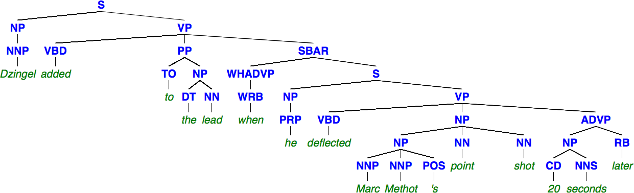
Semantic Parsing
The process of converting a sentence in a natural language to a formal meaning representation.
Word order and word type/role provide the word’s attributes.

Slide 24
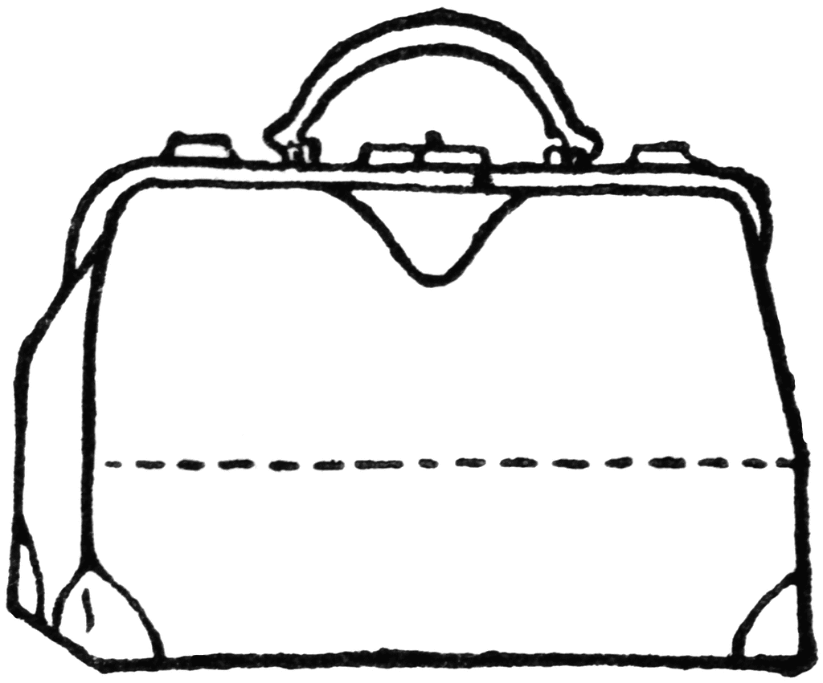
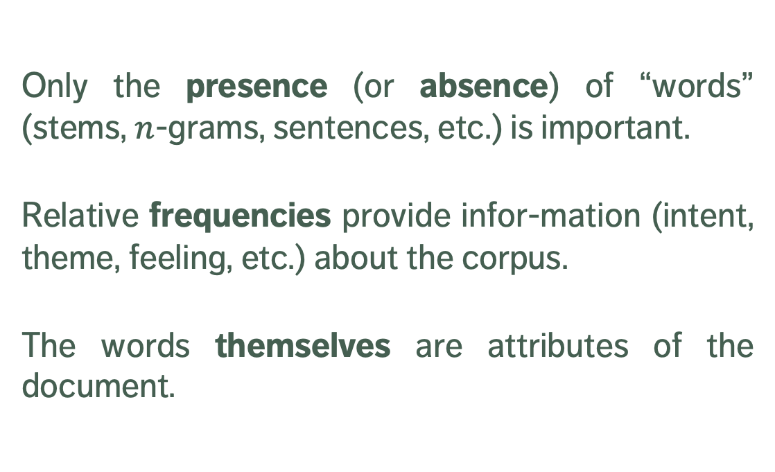
Bag of “Words” (BoW)
Only the presence (or absence) of “words” (stems, $n$-grams, sentences, etc.) is important.
Relative frequencies provide infor-mation (intent, theme, feeling, etc.) about the corpus.
The words themselves are attributes of the document.
‘s, 20, added, deflected, Dzingel, he, later, lead, Marc, Methot, point, seconds, shot, the, to, when
Notes:
After this section, we will spend the rest of the section looking at the fundamental concepts underlying Text Preparation.
Concrete illustrations of these notions are provided in the Notebooks and Examples.

Slide 25
Text Processing
Text data requires extensive cleaning and processing.
There are a number of challenges due to the nature of the data:
what is an anomaly in the text?
what is an outlier?
are these concepts even definable?
how do we deal with encoding errors?
Spelling mistakes and typographical errors are difficult to catch in large documents, even with spell-checkers.

Slide 26
Text Processing
The process can be simplified to some extent with the help of regular expressions and text pre-processing functions.
Specific pre-processing steps vary depending on the problem:
tweetish uses a different vocabulary than legalese
ditto for a child who’s learning to speak and a Ph.D. candidate
As is almost everything else related to text mining, the cleaning process is strongly context-dependent.
Note that the order of pre-processing tasks can affect results.
Notes:
NOTE: Specific pre-processing steps will vary based on the project.
For instance, the words used in tweets are vastly different from those used in legal documents.
So, the cleaning process can also be quite different.

Slide 27
TEXT PROCESSING
“Dzingel added lead deflected Marc Methot point shot twenty seconds later”
______________________________
added, deflected, Dzingel, later, lead, Marc, Methot, point, seconds, shot, twenty

Slide 28
Text Processing – OPTIONS
Convert all letters to lower case (avoid when seeking names)
Remove all punctuation marks (avoid if seeking emojis)
Remove all numerals (avoid when mining for quantities)
Remove all extraneous white space
Remove characters within brackets (avoid if seeking tags)
Replace all numerals with words
Notes:
You may want to remove title here and put four items in each slide

Slide 29
Text Processing – OPTIONS
Replace abbreviations
Replace contractions (avoid if seeking non-formal speech)
Replace all symbols with words
Remove stop words and uninformative words (language-, era- and context-dependent)
Stem words and complete stems to remove empty variation
“sleepiness”, “sleeping”, “sleeps”, “slept” convey the meaning of “sleep”
in “operations research”, “operating systems” and “operative dentistry”, the stem “operati” needs to stand it for different meanings
Notes:
You may want to remove title here and put four items in each slide

Slide 30
Text Processing
Phonetic accent representation ya new cah’s wicked pissa!
Neologisms and portmanteaus I’m planning prevenge?
Poor translations/foreign words
Puns and play-on-words
Mark-up, tags, and uninformative text <b>; \includegraphics; ISBN blurb
Specialized vocabulary clopen; poset; retro encabulator
Fictional names and places Qo’noS; Kilgore Trout
Slang and curses skengfire; #$&#!

Slide 31
EXERCISE
How would you process the following bit of text?
“<i>He<i> went to bed at 2 A.M. It\’s way too late! He was only 20% asleep at first, but sleep eventually came.”

Slide 32
Text Representation
Text must be stored to data structures with right properties:
a string or vector of characters, with language-specific encoding
a corpus (collection) of text documents (with meta information)
a document-term matrix (DTM) where the rows are documents, the columns are terms, and the entries are an appropriate text statistic (or the transposed term-document matrix (TDM)
a tidy text dataset with one token (single word, n-gram, sentence, paragraph) per row
No magic recipe: best format depends on the problem at hand. But this step is crucial, both for semantic analysis and BoW.
Notes:
Corpus has two types:
‘permanent’ when stored on disk
‘volatile’ when held in RAM

Slide 33
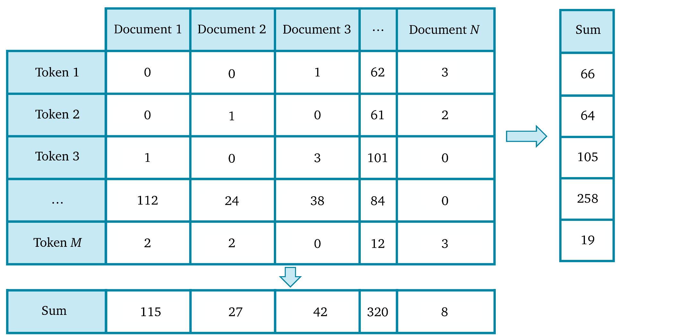
DTM/TDM Representation
Notes:
Term-Document Matrix / Document-Term Matrix for a hypothetical corpus, with row sums and column sums

Slide 34
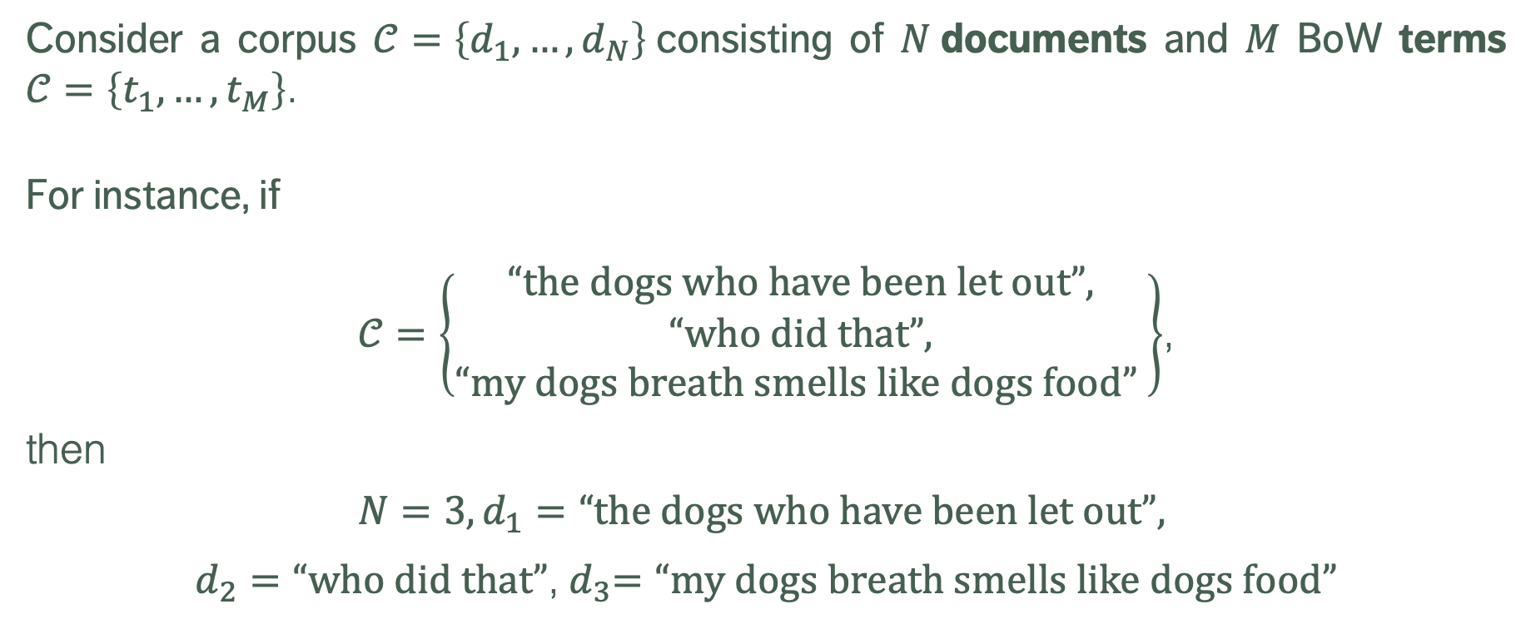
Text Statistics
Consider a corpus $𝒞=\left\{d_{1},…,d_{N}\right\}$consisting of $N$documents and $M$ BoW terms $𝒞=\left\{t_{1},…,t_{M}\right\}$.
For instance, if
$𝒞=\left\{\begin{aligned}\text{“}\text{the} \text{dogs} \text{who} \text{have} \text{been} \text{let} \text{out}\text{”}, \\ \text{“}\text{who} \text{did} \text{that}\text{”}, \\ \text{“}\text{my} \text{dogs} \text{breath} \text{smells} \text{like} \text{dogs} \text{food}\text{”} \end{aligned}\right\}$,
then
$$N=3, d_{1}=\text{“}\text{the} \text{dogs} \text{who} \text{have} \text{been} \text{let} \text{out}\text{”},$$
$d_{2}=\text{“}\text{who} \text{did} \text{that}\text{”}$,${ d}_{3}=\text{“}\text{my} \text{dogs} \text{breath} \text{smells} \text{like} \text{dogs} \text{food}\text{”}$

Slide 35
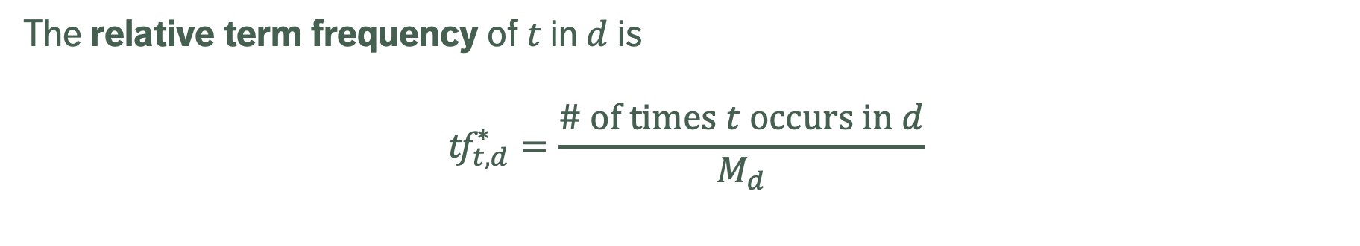
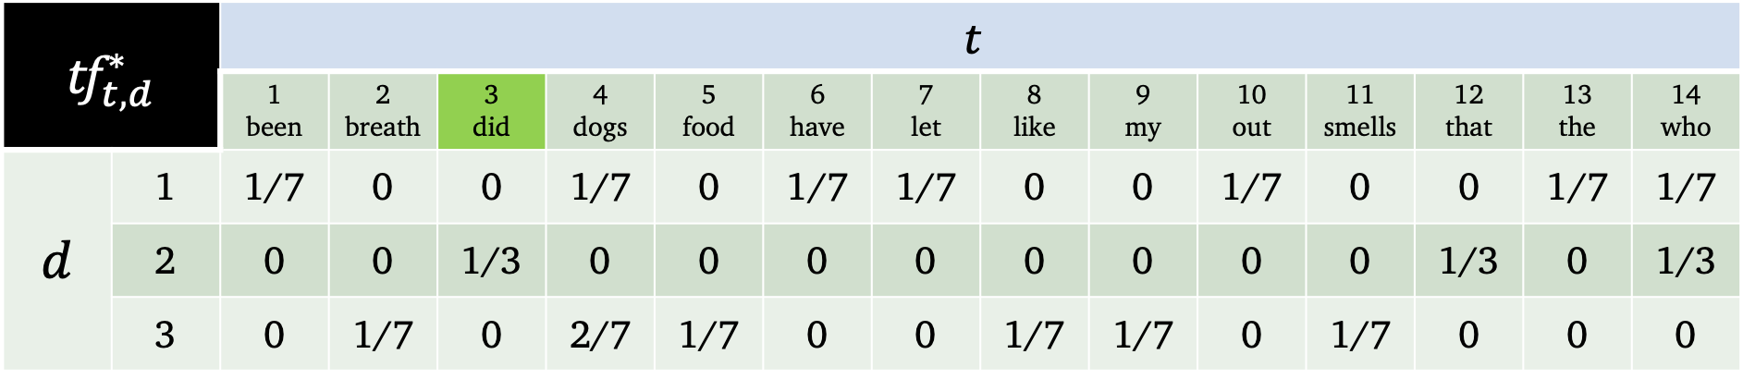
Text Statistics
The relative term frequency of $t$ in $d$ is
$${\text{tf}}_{t,d}^{∗}=\frac{\text{\# }\text{of} \text{times} t \text{occurs} \text{in} d}{M_{d}}$$
$${\text{tf}}_{t,d}^{∗}$$ |  | $$t$$
 |  | 1 been | 2 breath | 3 did | 4 dogs | 5 food | 6 have | 7 let | 8 like | 9 my | 10 out | 11 smells | 12 that | 13 the | 14 who
$$d$$ | 1 | 1/7 | 0 | 0 | 1/7 | 0 | 1/7 | 1/7 | 0 | 0 | 1/7 | 0 | 0 | 1/7 | 1/7
 | 2 | 0 | 0 | 1/3 | 0 | 0 | 0 | 0 | 0 | 0 | 0 | 0 | 1/3 | 0 | 1/3
 | 3 | 0 | 1/7 | 0 | 2/7 | 1/7 | 0 | 0 | 1/7 | 1/7 | 0 | 1/7 | 0 | 0 | 0

Slide 36
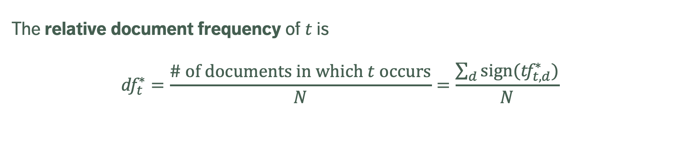
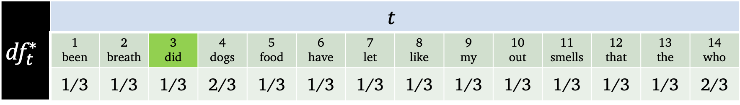
Text Statistics
The relative document frequency of $t$ is
$${\text{df}}_{t}^{∗}=\frac{\text{\# }\text{of} \text{documents} \text{in} \text{which} t \text{occurs}}{N}=\frac{\sum_{d}{\text{sign}({\text{tf}}_{t,d}^{∗})}}{N}$$
$${\text{df}}_{t}^{∗}$$ | $$t$$
 | 1 been | 2 breath | 3 did | 4 dogs | 5 food | 6 have | 7 let | 8 like | 9 my | 10 out | 11 smells | 12 that | 13 the | 14 who
 | 1/3 | 1/3 | 1/3 | 2/3 | 1/3 | 1/3 | 1/3 | 1/3 | 1/3 | 1/3 | 1/3 | 1/3 | 1/3 | 2/3

Slide 37

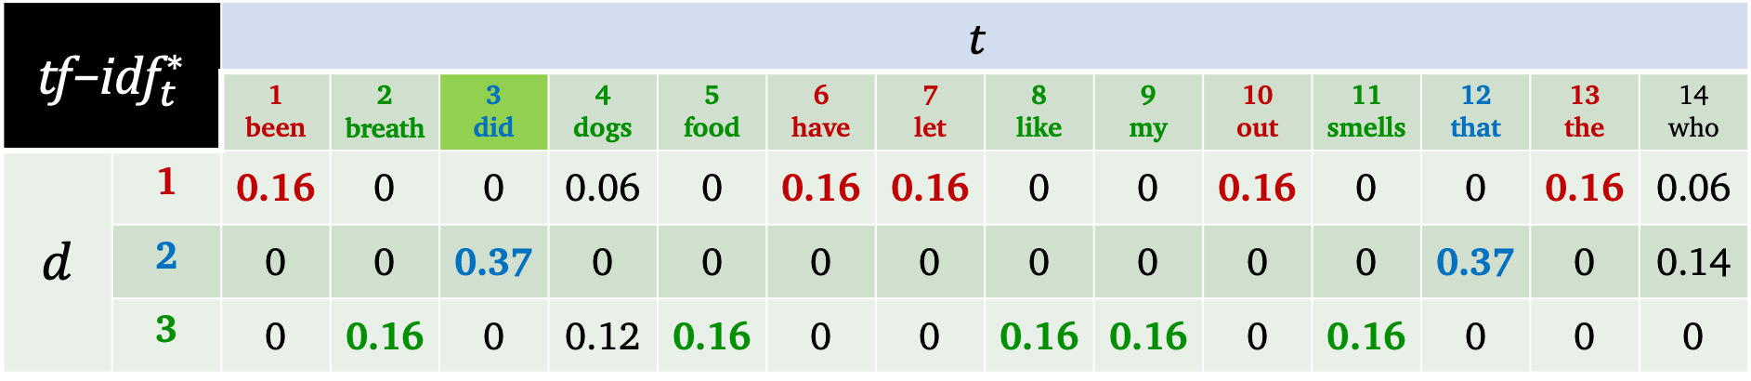
Text Statistics
The term frequency – inverse document frequency of $t$ in $d$ is
$${\text{tf}\text{−}\text{idf}}_{t,d}^{∗}=−{\text{tf}}_{t,d}^{∗}× \text{ln}\left({\text{df}}_{t}^{∗}\right)$$
$${\text{tf}\text{−}\text{idf}}_{t}^{∗}$$ |  | $$t$$
 |  | 1 been | 2 breath | 3 did | 4 dogs | 5 food | 6 have | 7 let | 8 like | 9 my | 10 out | 11 smells | 12 that | 13 the | 14 who
$$d$$ | 1 | 0.16 | 0 | 0 | 0.06 | 0 | 0.16 | 0.16 | 0 | 0 | 0.16 | 0 | 0 | 0.16 | 0.06
 | 2 | 0 | 0 | 0.37 | 0 | 0 | 0 | 0 | 0 | 0 | 0 | 0 | 0.37 | 0 | 0.14
 | 3 | 0 | 0.16 | 0 | 0.12 | 0.16 | 0 | 0 | 0.16 | 0.16 | 0 | 0.16 | 0 | 0 | 0

Slide 38
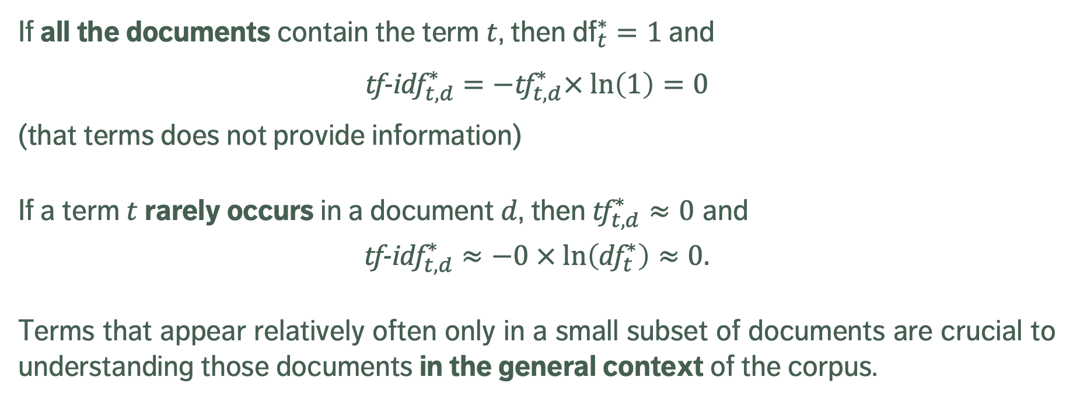
Text Statistics
If all the documents contain the term $t$, then ${\text{df}}_{t}^{∗}=1$ and
$${\text{tf}\text{−}\text{idf}}_{t,d}^{∗}=−{\text{tf}}_{t,d}^{∗}× \text{ln}\left(1\right)=0$$
(that terms does not provide information)
If a term $t$ rarely occurs in a document $d$, then${\text{tf}}_{t,d}^{∗}≈0$ and
$${\text{tf}\text{−}\text{idf}}_{t,d}^{∗}≈−0 × \text{ln}\left({\text{df}}_{t}^{∗}\right)≈0.$$
Terms that appear relatively often only in a small subset of documents are crucial to understanding those documents in the general context of the corpus.

Slide 39
DISCUSSION
At the analysis stage, it is easy to forget where the data comes from and what it really applies to.
Text comes unstructured and unorganized. After processing, text is clean, but still unstructured. Bag of Words provides a framework for a structured numerical representation of text.
How does this affect the choice of text statistic in the DTM/TDM?

Slide 40
Sentiment Analysis
TEXT MINING AND SENTIMENT ANALYSIS
“[…] classifying social media posts by hand isn’t practical at scale (though some firms do manually classify samples to make their algorithms better). But a simple thumbs up or down as “sentiment” is worse than meaningless–it’s simply not true.”
(S. Kessler, The Problem With Sentiment Analysis)

Slide 41
Basics
Most of us have a good native understanding of the emotional intent of words, which leads us to infer surprise, disgust, joy, pain (and so forth) from a text segment
The process, when applied by machines to a block of text, is called sentiment analysis (opinion mining).
Typical SA questions:
“Is this movie review positive or negative?”
“Is this customer email a complaint?”
“Have newspapers’ attitudes about the PM changed since the election?”

Slide 42
Challenges
Most humans would typically be able to answer these questions when presented with the appropriate text documentation. For machines, that is not as obvious a problem to solve.
Challenges:
we don't always agree on the emotional content of a text
words may have different meaning/emotional value depending on the context (anti-antonyms)
qualifiers can drastically change a term's emotional value
topic changes
rhetorical devices

Slide 43
Related Tasks
Sentiment analysis is a supervised learning problem, requiring dictionaries of emotional content to have been compiled ahead of time (internally or externally)
Related Tasks:
discarding subjective information (information extraction)
recognizing opinion-oriented questions (question answering)
accounting for multiple viewpoints (summarization)
identifying suitability of videos for kids, bias in news sources, and appropriate content for ad placement
Element of subjectivity

Slide 44
EXERCISE
Three reviews (1-star, 3-star, 5-star) were found on Amazon.ca. Can you identify them? Can you identify the product?
“Love the jeans, price, fit, but even more, love the suppliers. Simple concerns were not only answered immediately, they went beyond any expectations I had! Will definitely be buying through this supplier, highly recommended!”
“DON'T BUY. Great series aside, this special addition is pathetic. They're basically mass-market paperbacks: small and uncomfortable to hold. The regular paperback versions are far superior for basically the same price.”
“Beginning the second use, the bowl keeps falling out 30 seconds after the mixing starts. A bit disappointed.”

Slide 45
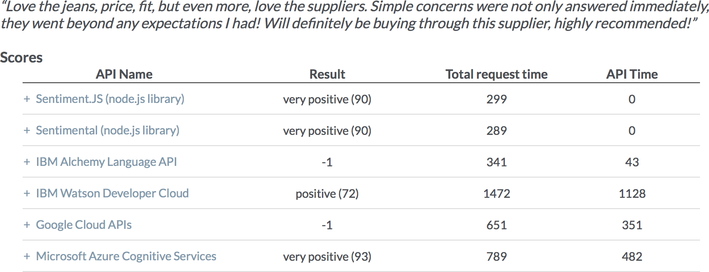
[http://aiplaybook.a16z.com/docs/guides/nlp#user-content-apiexamples]

Slide 46
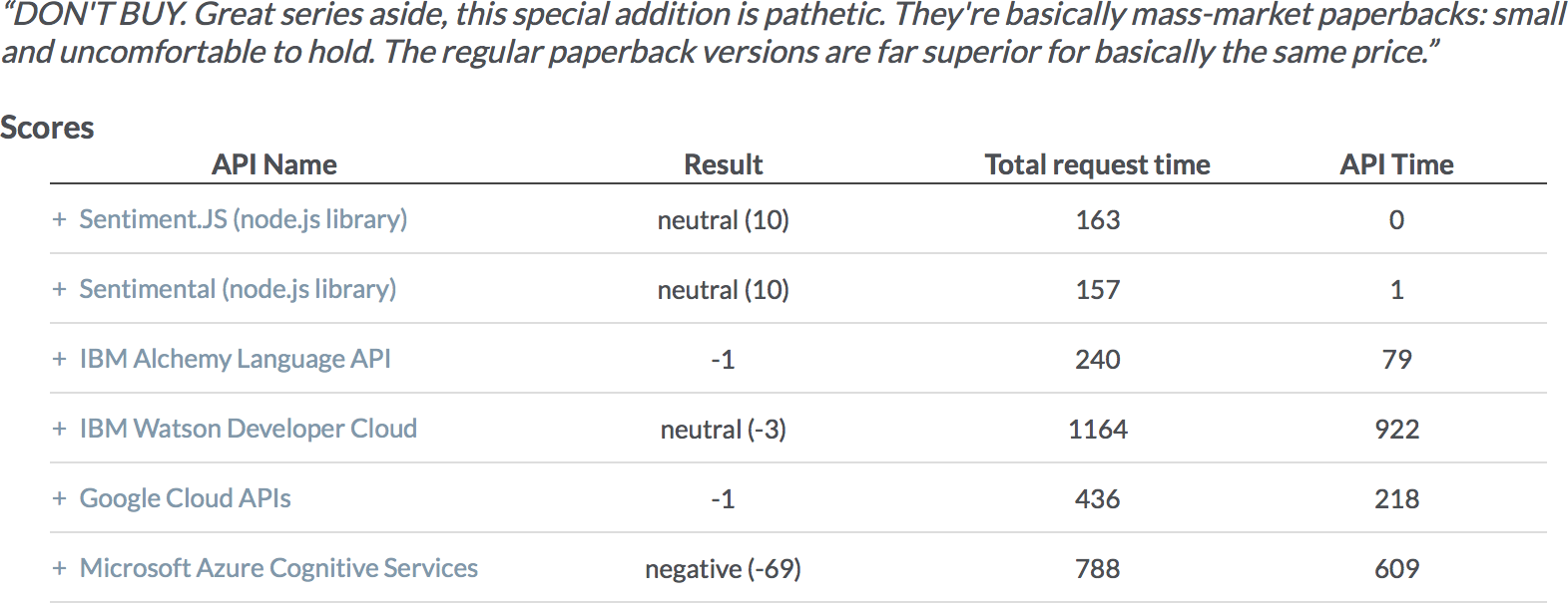
[http://aiplaybook.a16z.com/docs/guides/nlp#user-content-apiexamples]

Slide 47
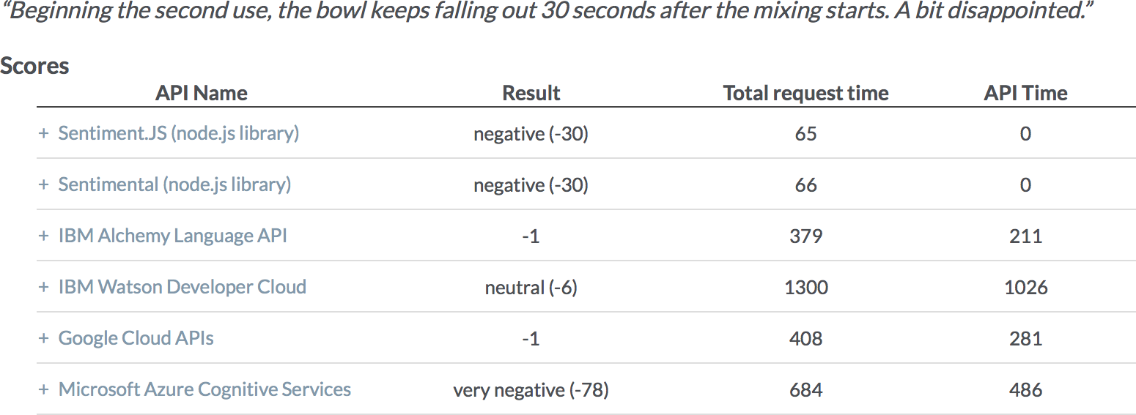
[http://aiplaybook.a16z.com/docs/guides/nlp#user-content-apiexamples]

Slide 48
Types OF SENTIMENT ANALYSIS
In this course, we differentiate 2 types of sentiment analyses:
term-by-term (tbt) looks at the emotional content of tokens and tries to deduce a score for passages containing them
document-by-document (dbd) looks at scored passages and tries to find tokens which carry the emotional load or predict how a new passage would score on some emotional spectrum
TBT is not a complicated technical task: it only requires the ability to match a lexicon score to a term, and to add the scores.
DBD is basically a classification problem – it requires labeled text data, but the principle is exactly the same: predict “positive/negative” labels.

Slide 49
Sentiment Lexicons
TBT sentiment analysis relies heavily on lexicons – list of terms which have been ranked on some emotional scale
AFINN: words on a scale from -5 (negative) to 5 (positive)
BING: binary negative/positive
NRC: words are assigned category(ies) of sentiments
LOUGHRAN: categorical bins
Each of these lexicons contains a majority of negative terms.
The best choice of lexicon is dictated by context.

Slide 50
Sentiment Lexicons
“abandon”
AFINN: -2 BING: NA NRC: fear, negative, sadness LOUGHRAN: negative
“bad”
AFINN: -3 BING: negative NRC: anger, disgust, fear, etc. LOUGHRAN: negative
“not”
AFINN: NA BING: NA NRC: NA LOUGHRAN: NA
“egregious”
AFINN: ? BING: ? NRC: ? LOUGHRAN: ?

Slide 51
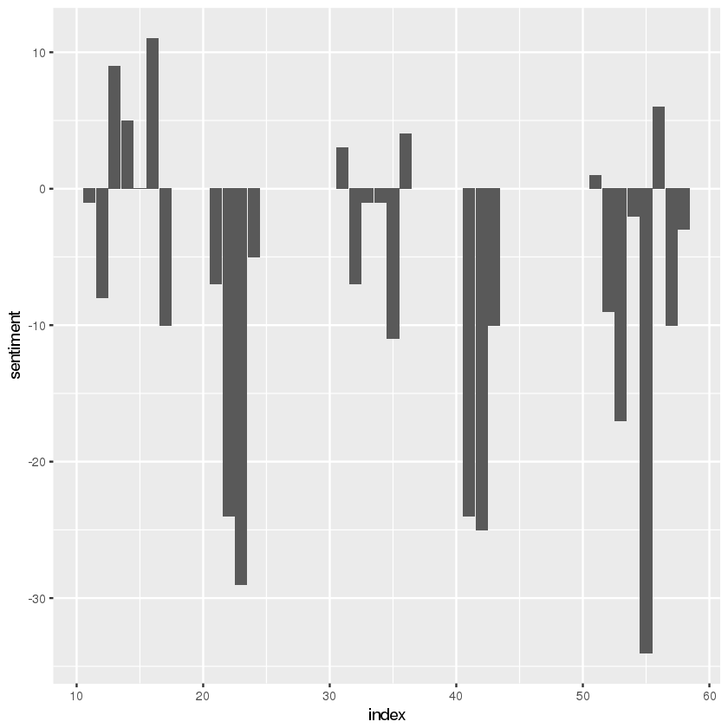
Sentiment Lexicons
Once a lexicon has been selected, TBT is simply a matter of chunking the text and computing sentiment scores on each block (every 100 words, every 100 lines, every chapter, etc.)
Is there any reason to expect the various lexicons to give the same scores?
(Shakespeare’s Macbeth, AFINN scene scores)

Slide 52
DISCUSSION
Most words in the English language are neutral. Why are most lexicon words negative, then? Is this also the case for written Chinese? For French?
Are lexicons interchangeable (time, culture, context)?

Slide 53
EXAMPLE: MOVIE REVIEWS
TEXT MINING AND SENTIMENT ANALYSIS
“No good movie is too long and no bad movie is short enough”
(Roger Ebert)

Slide 54
STATEMENT OF EXERCISE
The emphasis of this exercise is not on programming; rather it is to showcase a complete analytical workflow using Python’s Natural Language Toolkit (NLTK).
The goal is to develop a sentiment analysis model for movie reviews. The dataset contains 50000 movie reviews labeled as either positive or negative.
With an accurate sentiment model we'll have the ability to automatically classify new reviews in order to aggregate review data, say.

Slide 55
EXERCISE
Dataset Information
How many positive reviews are there in the training set? How many negative reviews?
How many positive reviews are there in the testing set? How many negative reviews?
What is the range of scores for positive and negative reviews in the training and testing sets?
What effect can the absence of neutral reviews in the training and testing set have?
Data Preparation
Select 10 words which you think explain why the review of Haunted Boat (3446_1.txt) is a 1-star review.
Select 10 words which you think explain why the review of Night Listener (10015_8.txt) is an 8-star review.

Slide 56
EXERCISE
Bag-of-Words Processing
All the processed tokens in all the training set reviews are used to create a document-term matrix (DTM). Describe the process to go from the full review text to the review tokens.
How many tokens are retained in the DTM?
How is this number dependent on the nature of the tokenizer? (notice the mistake in the notebook: the shape provided by the output is not the shape described in the explanation).
Multinomial Naïve Bayes
Does the multinomial naïve Bayes classifier built on the training DTM suggests that review 9999_1.txt is positive or negative? Are any of the words you identified in Question 2 found in this review.
Same question, but for review 9999_10.txt.

Slide 57
EXERCISE
Performance Evaluation
Describe the sentiment analyzer’s performance provided by the classification report.
Why do you think that the performance of VADER (NLTK’s pre-trained sentiment analyzer) poorer than the model that was trained on the review data?

Slide 58
REFERENCES
TEXT MINING AND SENTIMENT ANALYSIS

Slide 59
NOTEBOOKS
Text Processing, Text Visualization, Text Clustering, Sentiment Analysis Notebooks (in HTML format) https://www.data-action-lab.com/wp-content/uploads/2019/03/TMNotebooks.zip

Slide 60
References
Basu, T. [2017], NPR's Fascinating Plan to Use A.I. on Trump's Tweets, retrieved from inverse.com on September 12, 2017.
Goldmark, A. [2017], Episode 763: BOTUS, Planet Money podcast, retrieved from NPR.org's Planet Money on September 12, 2017.
Greenstone, S. [2017], When Trump Tweets, This Bot Makes Money, retrieved from NPR.org on September 12, 2017
Mettler, K. [2017], ‘Trump and Dump’: When POTUS tweets and stocks fall, this animal charity benefits, retrieved from the Washington Post on September 19, 2017
Jockers, M.L. [2014], Text Analysis with R for Students of Literature, Springer.
Anastasia, D.C., Tagarelli, A., Karypis, G. [2014], Document Clustering: The Next Frontier, in Data Clustering: Algorithms and Applications (Aggarwal, C.C., Reddy, C.K., eds.), CRC Press.

Slide 61
References
Aggarwal, C.C., Zhai, C.X. [2015], Text Classification, in Data Classification: Algorithms and Applications (Aggarwal, C.C., ed.), CRC Press.
Srivastava, A.N., Sahami, M. (eds.) [2009], Text Mining: Classification, Clustering, and Applications, CRC Press.
Silge, J., Robinson, D. [2017], Text Mining with R: a Tidy Approach, O’Reilly.
Jurafsky, D., Martin, J.H. [2009], Speech and Language Processing (2nd ed), Pearson.
Aggarwal, C.C., Zhai, C.X. (eds.) [2012], Mining Text Data, Springer.
Bird, S., Klein, E., Loper, E. [2009], Natural Language Processing with Python, O’Reilly.
http://aiplaybook.a16z.com/docs/guides/nlp#user-content-apiexamples
https://azure.microsoft.com/en-us/services/cognitive-services/text-analytics/

Slide 62
SUPPLEMENTAL MATERIAL – MULTINOMIAL NAÏVE BAYES CLASSIFICATION
TEXT MINING AND SENTIMENT ANALYSIS

Slide 63
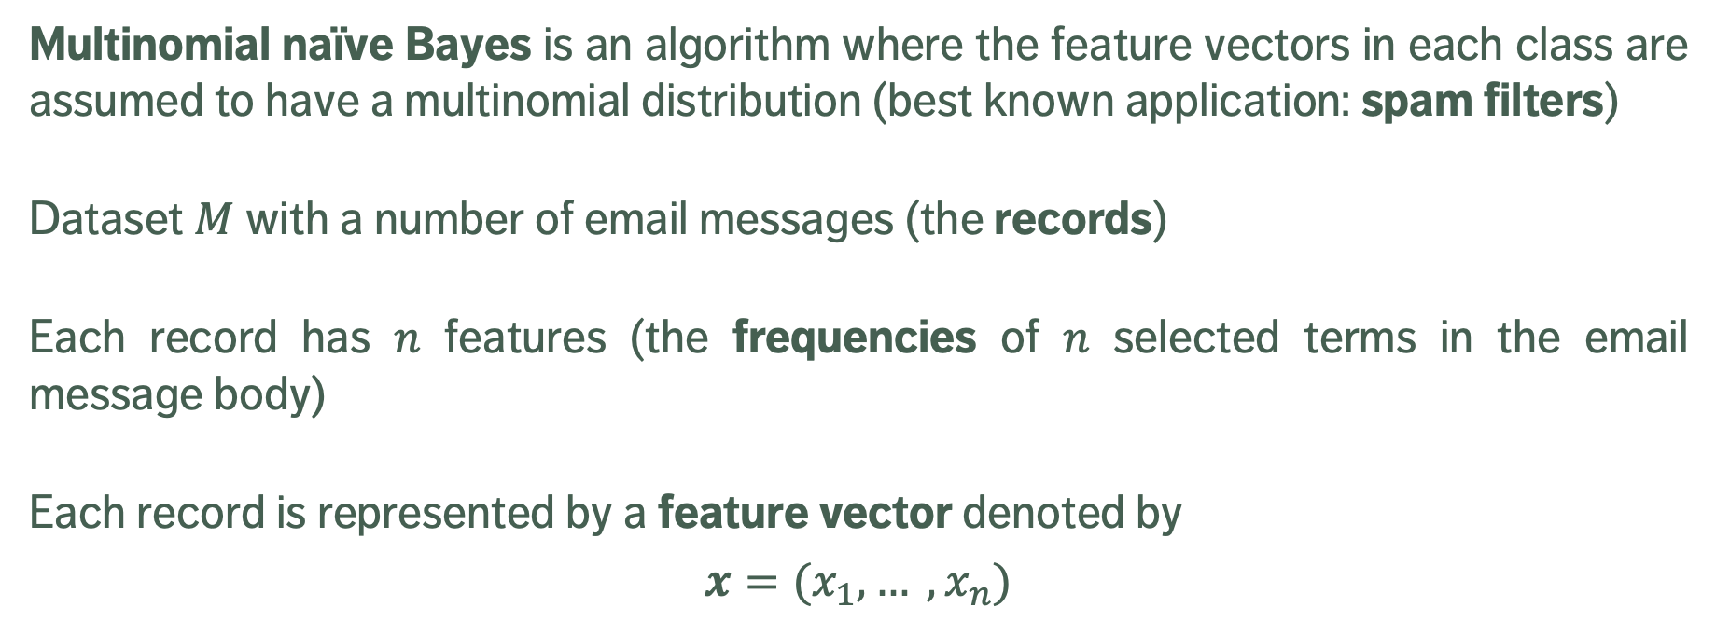
Multinomial Naïve Bayes Classification
Multinomial naïve Bayes is an algorithm where the feature vectors in each class are assumed to have a multinomial distribution (best known application: spam filters)
Dataset $M$with a number of email messages (the records)
Each record has $n$ features (the frequencies of $n$ selected terms in the email message body)
Each record is represented by a feature vector denoted by
$$x=(x_{1}, … ,x_{n})$$

Slide 64
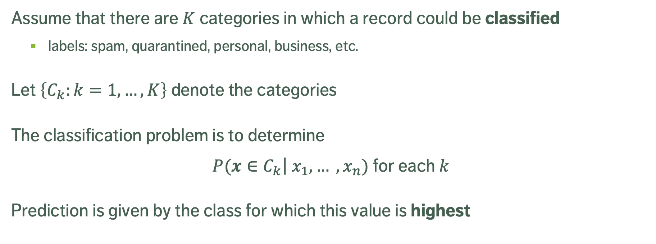
Multinomial Naïve Bayes Classification
Assume that there are $K$ categories in which a record could be classified
labels: spam, quarantined, personal, business, etc.
Let $\left\{C_{k}:k=1,…,K\right\}$ denote the categories
The classification problem is to determine
$P(x∈C_{k}$|${ x}_{1}, … ,x_{n})$ for each $k$
Prediction is given by the class for which this value is highest

Slide 65
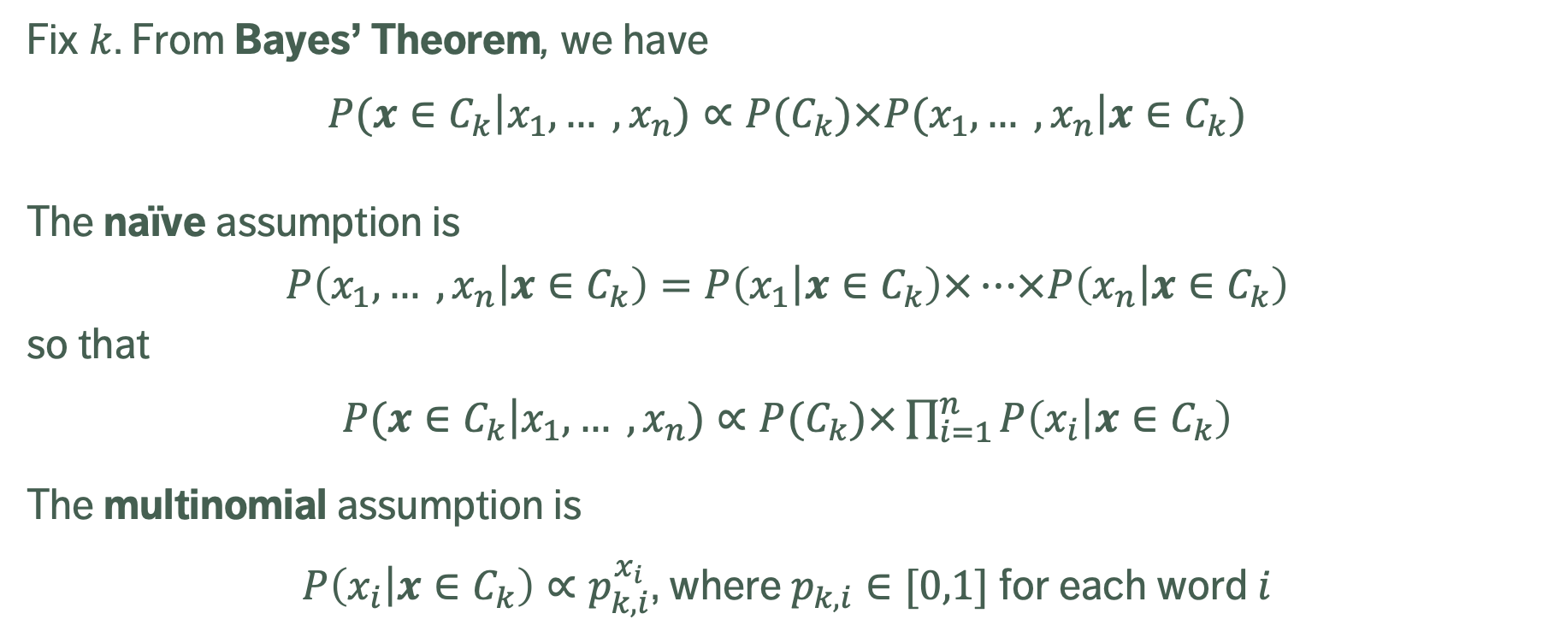
Multinomial Naïve Bayes Classification
Fix $k$. From Bayes’ Theorem, we have
$P(x∈C_{k}$|$x_{1}, … ,x_{n})∝P(C_{k})×P(x_{1}, … ,x_{n}\text{|}x∈C_{k})$
The naïve assumption is
$$P\left(x_{1}, … ,x_{n}\text{|}x∈C_{k}\right)=P\left(x_{1}\text{|}x∈C_{k}\right)×…×P\left(x_{n}\text{|}x∈C_{k}\right)$$
so that
$P(x∈C_{k}$|$x_{1}, … ,x_{n})∝P(C_{k})×\prod_{i=1}^{n}{P\left(x_{i}\text{|}x∈C_{k}\right)}$
The multinomial assumption is
$P\left(x_{i}\text{|}x∈C_{k}\right)∝p_{k,i}^{x_{i}}$, where $p_{k,i}∈[0,1]$ for each word $i$

Slide 66
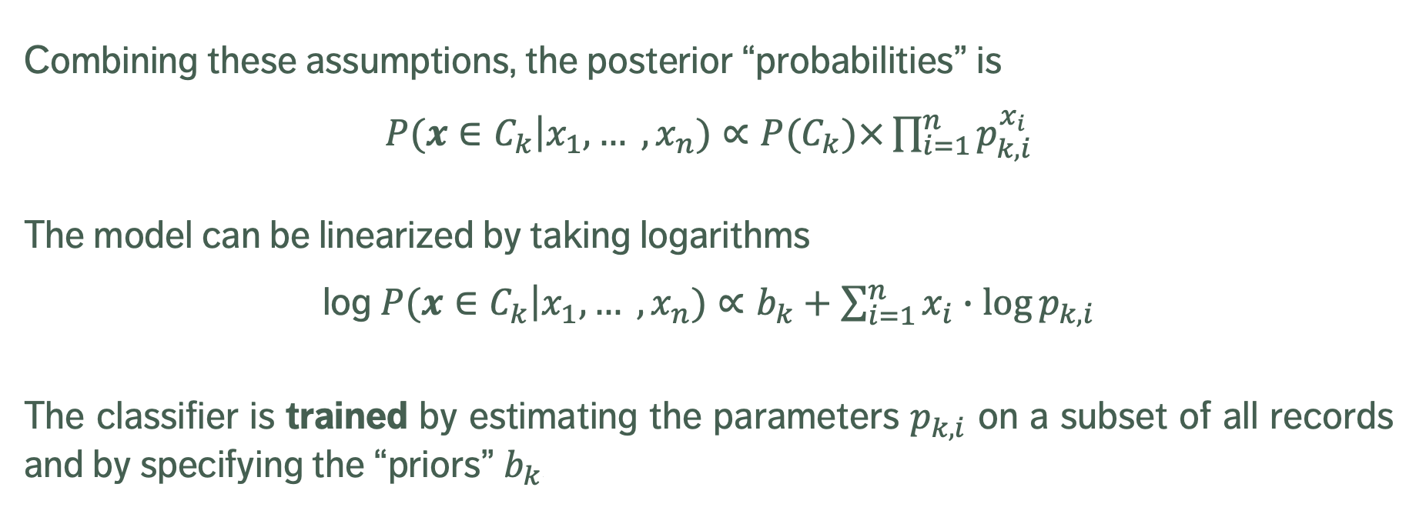
Multinomial Naïve Bayes Classification
Combining these assumptions, the posterior “probabilities” is
$P(x∈C_{k}$|$x_{1}, … ,x_{n})∝P(C_{k})×\prod_{i=1}^{n}{p_{k,i}^{x_{i}}}$
The model can be linearized by taking logarithms
$\text{log} P(x∈C_{k}$|$x_{1}, … ,x_{n})∝b_{k}+\sum_{i=1}^{n}{x_{i}∙\log{p_{k,i}}}$
The classifier is trained by estimating the parameters $p_{k,i}$ on a subset of all records and by specifying the “priors” $b_{k}$.

Slide 67
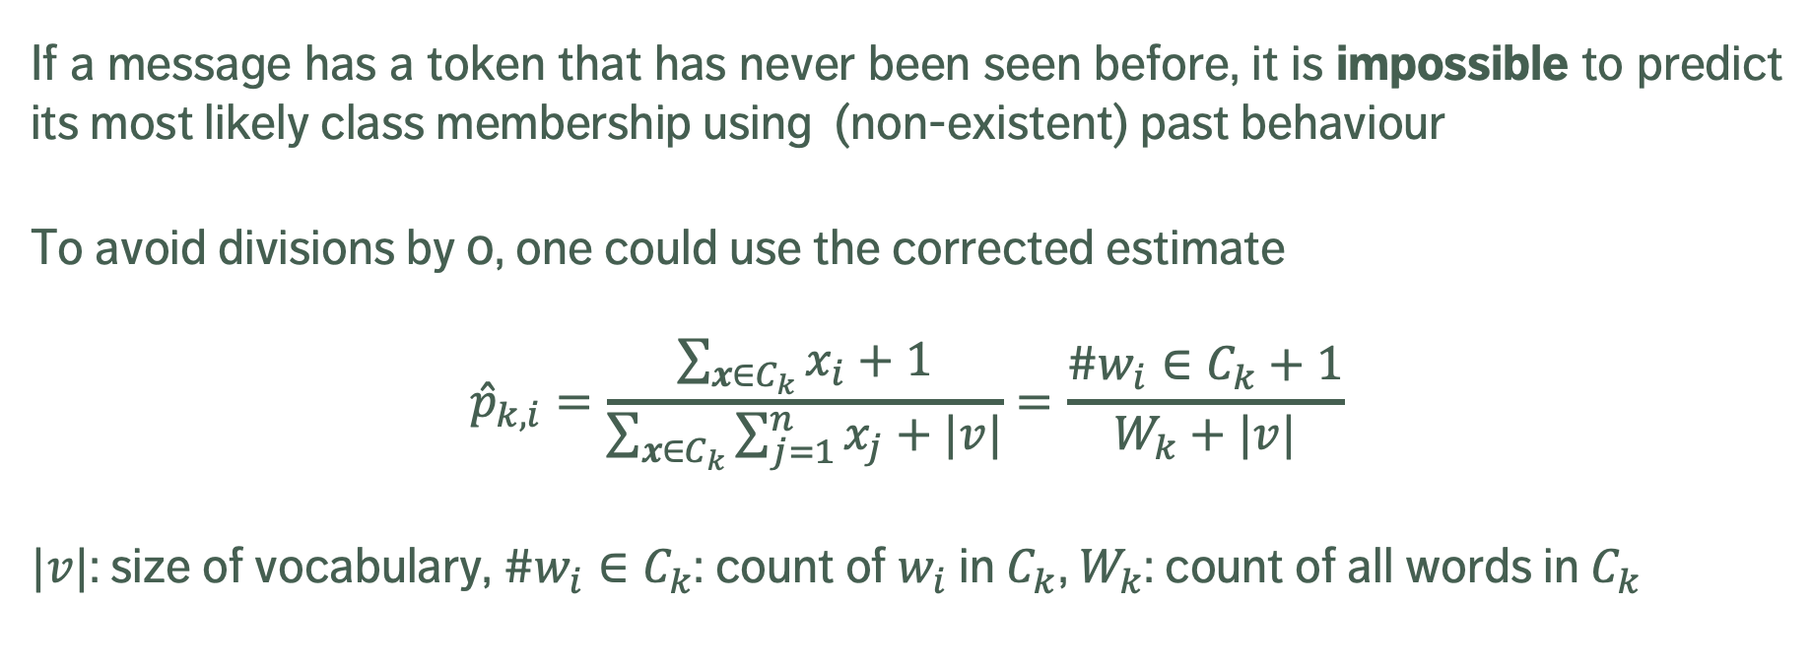
Multinomial Naïve Bayes Classification
If a message has a token that has never been seen before, it is impossible to predict its most likely class membership using (non-existent) past behaviour
To avoid divisions by 0, one could use the corrected estimate
$${\hat{p}}_{k,i}=\frac{\sum_{x∈C_{k}}{x_{i}}+1}{\sum_{x∈C_{k}}{\sum_{j=1}^{n}{x_{j}+|v|}}}=\frac{{\#w}_{i}∈C_{k}+1}{W_{k}+|v|}$$
$|v|$: size of vocabulary, ${\#w}_{i}∈C_{k}$: count of $w_{i}$ in $C_{k}$, $W_{k}$: count of all words in $C_{k}$

Slide 68
Multinomial Naïve Bayes Classification
Training set
cl ID text
+ i1 I love this phone
+ i2 amazing sound quality
+ i3 Love this great phone
- i4 i hate it
- i5 bad quality
- i6 so bad Hate it
Testing set
?? i7 hate hate HATE the phone quality
Processed training set
cl ID text
+ i1 love phone
+ i2 amazing sound quality
+ i3 love great phone
- i4 hate
- i5 bad quality
- i6 bad hate
Processed testing set
?? i7 hate hate hate phone quality

Slide 69
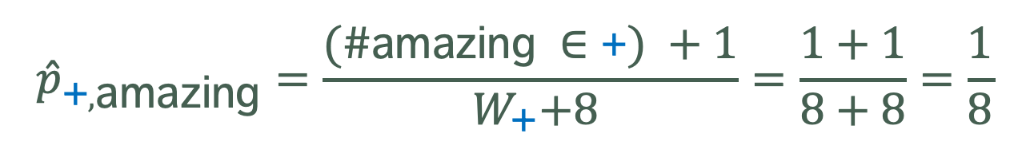
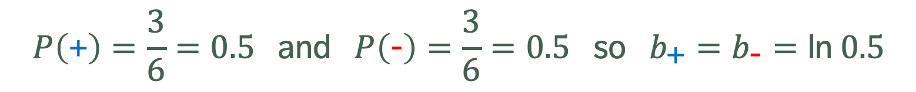
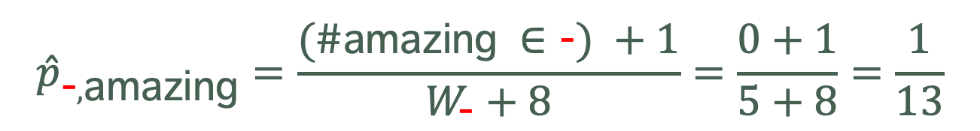
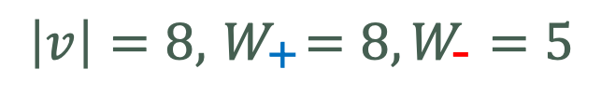
Multinomial Naïve Bayes Classification
$$P\left(\text{+}\right)=\frac{3}{6}=0.5 \text{and} P\left(\text{−}\right)=\frac{3}{6}=0.5 \text{so} b_{\text{+}}=b_{\text{−}}=\text{ln} 0.5$$
$$\left|v\right|=8,{ W}_{\text{+}}=8,W_{\text{−}}=5$$
$${\hat{p}}_{\text{+},\text{amazing}}=\frac{(\#\text{amazing} ∈\text{+}) +1}{{ W}_{\text{+}}+8}=\frac{1+1}{8+8}=\frac{1}{8}$$
$${\hat{p}}_{\text{−},\text{amazing}}=\frac{(\#\text{amazing} ∈\text{−}) +1}{W_{\text{−}}+8}=\frac{0+1}{5+8}=\frac{1}{13}$$
…

Slide 70
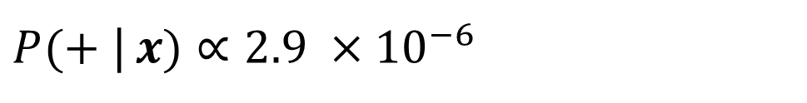
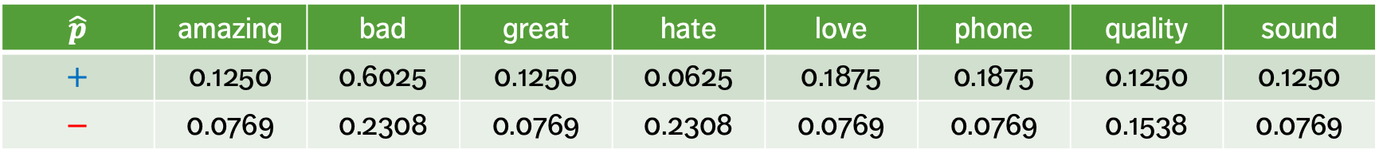
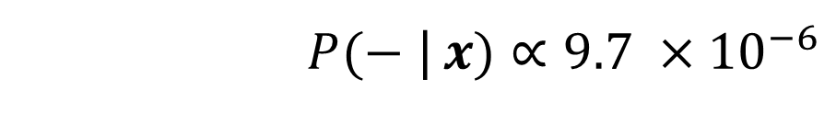
Multinomial Naïve Bayes Classification
$$\hat{p}$$ | amazing | bad | great | hate | love | phone | quality | sound
$$+$$ | 0.1250 | 0.6025 | 0.1250 | 0.0625 | 0.1875 | 0.1875 | 0.1250 | 0.1250
$$−$$ | 0.0769 | 0.2308 | 0.0769 | 0.2308 | 0.0769 | 0.0769 | 0.1538 | 0.0769
Testing set
 | amazing | bad | great | hate | love | phone | quality | sound
i7 | 0 | 0 | 0 | 3 | 0 | 1 | 1 | 0
$P(+$ |$x)∝2.9 ×{10}^{−6}$
$P(−$ |$x)∝9.7 ×{10}^{−6}$

